Slide 1
Constructing Textual Artificial Conversational Entities using Deep Learning
Group 2
Nicole Sandra-Yaffa Dumont, Sakif Hossain Khan, Kira Aveline Selby, Congcong Zhi
> hello computer
> hello world!

Slide 2
Introduction
Theory
Recurrent Neutral Networks
seq2seq Model
Implementation
Results & Demo
Conclusion

Slide 3
Introduction: Conversational Entities
Conversational Entity = Dialog System = Chatbot
Textual Conversational Entity = Chatbot which receives text and responds with text.
Contrast with auditory entity, which can receive voice messages and respond in kind.
Why chatbots and why now?
Lots of industry interest in constructing chatbots
Next-gen interfacing with consumer devices (e.g.: practical virtual assistants)
Automate and reduce friction in daily transactions
Continued alienation of people from each other under late capitalism

Slide 4
Background
Two flavors of chatbot
Retrieval-based agent: Given input, output response from a fixed, pre-defined set of responses
Generative agent: Given input, generate response from scratch; “smart” chatbot
Core problem to tackle: Natural Language Processing (NLP)
Automatically process, “understand” and generate language
NLP has a long history (starting with Turing) but modern NLP usually means statistical or distributional NLP
Current trend: Use deep (recurrent) neural networks to construct a generative entity

Slide 5
Pros of (R)NNs
End-to-end model: after some standard data cleaning and formatting, train and tune a single (large) model
Little to no feature engineering
Contrast with previous statistical NLP approaches which involve long and complicated pipelines
Minimal domain knowledge
Transferable models and learning: model for translation can also be used for conversational agent or other tasks and vice-versa

Slide 6
Cons of (R)NNs
Long training time
Difficult to explore hyperparameter combinations
Paucity of mathematical foundations
Lack of principled approaches for choosing model architecture and parameters
Black-box model
Difficult to debug if things go wrong

Slide 7
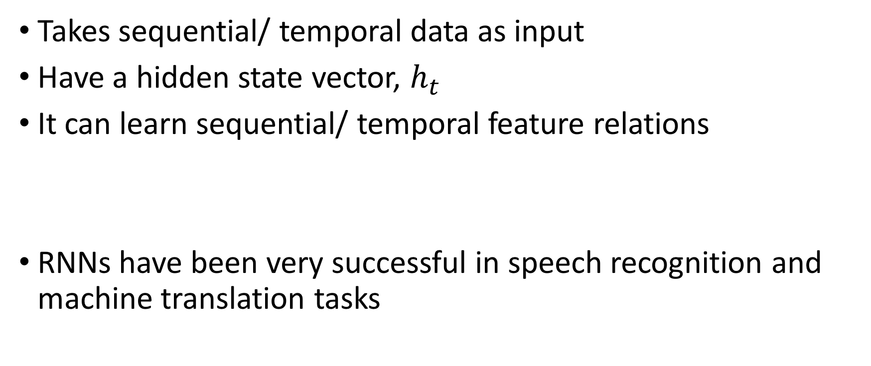
Recurrent Neural Networks (RNNs)
Takes sequential/ temporal data as input
Have a hidden state vector, $h_{t}$
It can learn sequential/ temporal feature relations
RNNs have been very successful in speech recognition and machine translation tasks

Slide 8
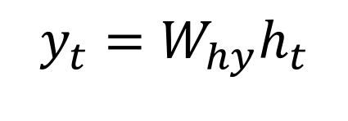
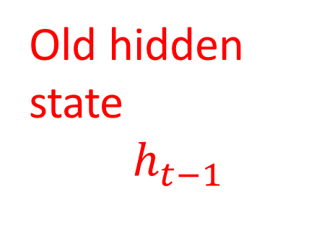
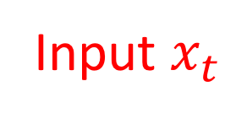
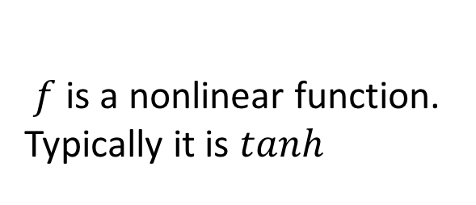
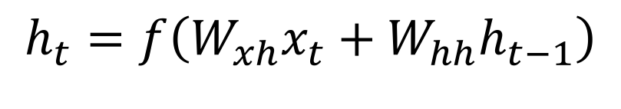
Recurrent Neural Networks (RNNs)
$$y_{t}=W_{hy}h_{t}$$
Old hidden state
$h_{t−1}$
$$h_{t}=f\left(W_{xh}x_{t}+W_{hh}h_{t−1}\right)$$
$f$is a nonlinear function.
Typically it is $tanh$
Input $x_{t}$

Slide 9
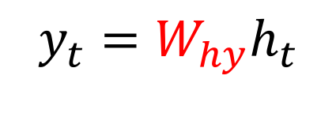
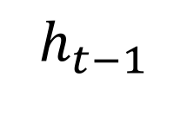
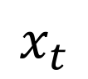
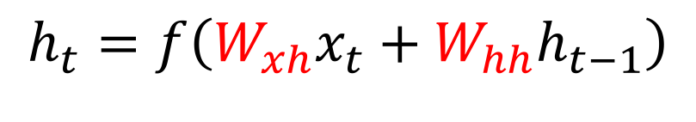
Recurrent Neural Networks (RNNs)
$$y_{t}=W_{hy}h_{t}$$
Weights
$$h_{t−1}$$
$$h_{t}=f\left(W_{xh}x_{t}+W_{hh}h_{t−1}\right)$$
$f$is a nonlinear function.
Typically it is $tanh$
$$x_{t}$$

Slide 10
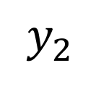
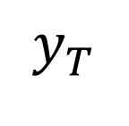
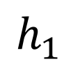
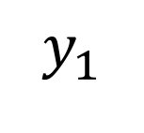
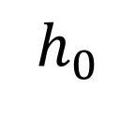
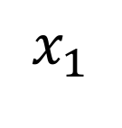
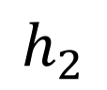
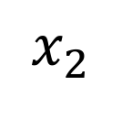
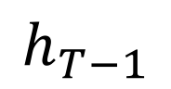
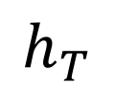
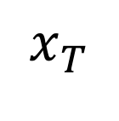
Unwinding this RNN layer,
$$y_{1}$$
$$y_{2}$$
$$y_{T}$$
$$h_{1}$$
$$h_{2}$$
$$h_{T−1}$$
$$h_{T}$$
. . .
$$h_{0}$$
$$x_{1}$$
$$x_{2}$$
$$x_{T}$$
Train with backpropagation through time (BPTT)

Slide 11
Long Short-Term Memory (LSTM)
Modification of RNNs: Have two hidden states and use more complicated functions (called gates)
Much better than simple RNNs at capturing long term temporal relations in data
Usually considered state of the art
Gated Recurrent Units (GRUs)
Fewer parameters than LSTMs
Perform just as well as LSTMs as long as the temporal dependence is not extremely long term

Slide 12
The seq2seq Model
Motivation:
Given variable length input, produce variable length output
Two RNNs: an encoder RNN, and a decoder RNN
The input is passed though the encoder. It’s final hidden state, called the “thought vector” is passed to the decoder as it’s initial hidden state.
Decoder given the start of sequence token, <SOS>, and iteratively produces output until it outputs the end of sequence token, <EOS>
Commonly used in text generation, machine translation, and related problems

Slide 13
seq2seq
I
am
doing
great
<EOS>
Encoder
How
are
you
<EOS>
<SOS>

Slide 14
seq2seq
Decoder
I
am
doing
great
<EOS>
How
are
you
<EOS>
<SOS>

Slide 15
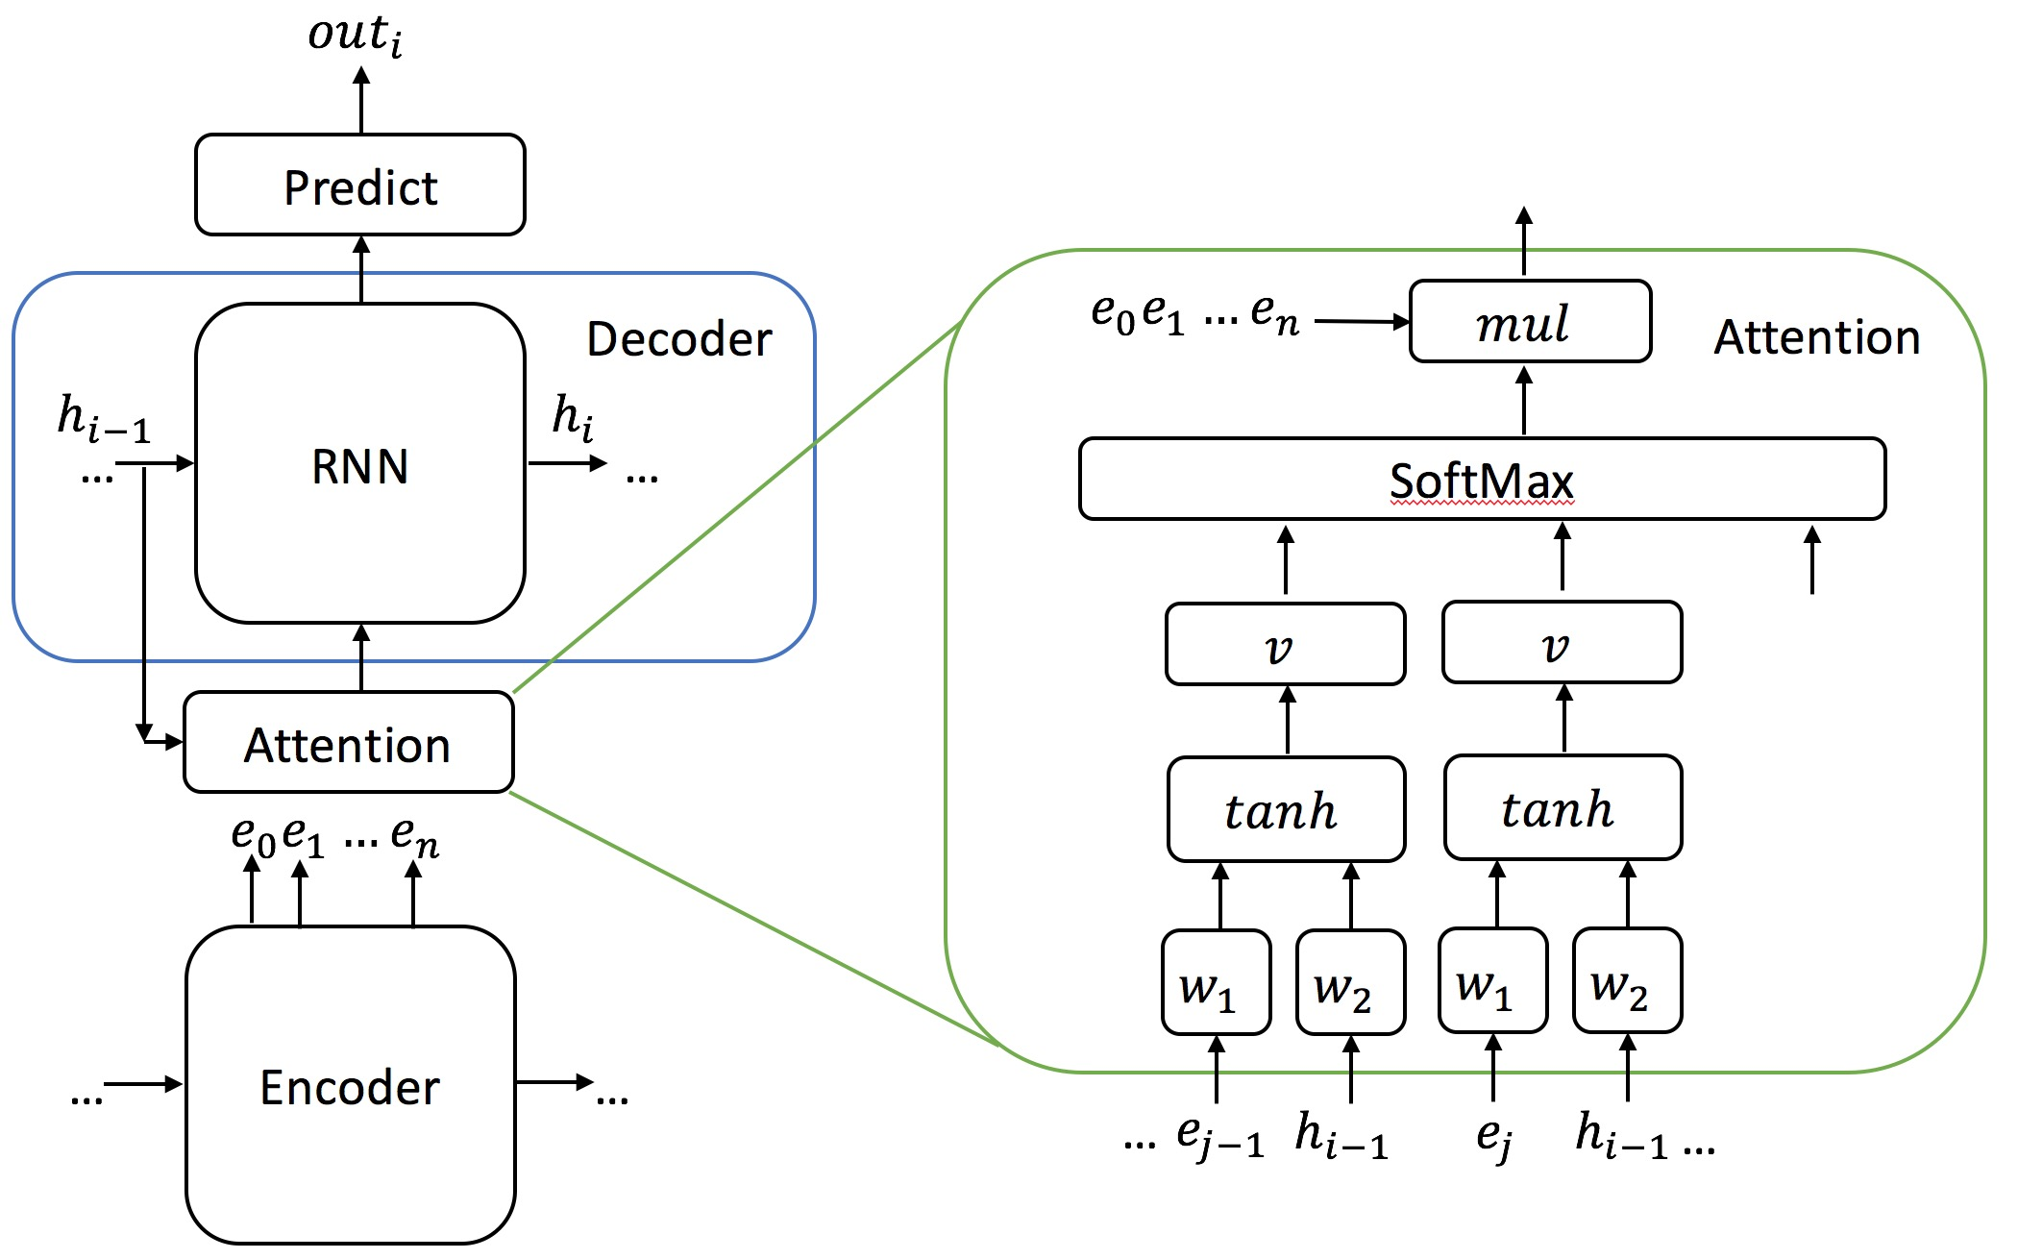
seq2seq: Attention
Advantage of using attention
Memory
Accuracy
How attention works
1) Attention weights
feed-forward layer:
encoder’s output and decoder’s hidden state as inputs
2) Multiplied by encoder output vectors

Slide 16
Our Model
We are using a package called PyTorch for our model
The model was adapted from an official PyTorch tutorial for machine translation, which can be found at pytorch.org/tutorials
Our model uses the Cornell Movie Dialog Corpus as training data
220,579 conversational exchanges between 10,292 pairs of movie characters
involves 9,035 characters from 617 movies
in total 304,713 utterances
We use a 2-4 layer GRU for both our encoder and decoder

Slide 17
Preprocessing
The data is preprocessed into a usable form by:
Removing punctuation and infrequently used words
Eliminating overly long sentences and padding the rest to equal length
Mapping each word to an index using dictionaries
The data is then organized into pairs of (message, response)
Batches are assembled from randomly selected pairs and converted to PyTorch tensors

Slide 18
Architecture
First, the data is passed through an embedding layer
The embedding layer converts the data from sequences of sparse n-dimensional vectors to dense d-dimensional vectors
It is trained end-to-end with the rest of the model
The data is then passed to the encoder, and goes through a multilayer GRU
The hidden state and outputs are passed to the decoder, which is then supplied the <SOS> token
The decoder generates words sequentially from the input and encoder state, informed by the attention module

Slide 19
Results
Our current models are trained on the MFCF GPU server for around a day
They produce some meaningful outputs, but often fixate on certain words and repeat them over and over
We are still working on improving and debugging the models to get better performance
Example Input | Model’s Output
For a model without attention or batches, trained for ~5 epoches

Slide 20
Demo

Slide 21
Future Work & Considerations
seq2seq: Beam Search
Evaluation
Human-based study
Multiple high-quality reference texts
Different Corpus

Slide 22
Future Work: Beam Search
Problem:
word with highest score at time t not necessarily giving you the sentence with highest probability
Beam Search:
width of m
At each time step, taking the top m proposal, decoding with each one of them

Slide 23
References

Slide 24
Questions?
> goodbye world!

